Slide 1
Establishing the Frame
Original use case was fact extraction and correlation – turned out that since content is spoken word, this is a lot more difficult than anticipated.
Dialed back to just making it easier to understand transcripts and the first item that seemed useful when reading was to color segments based on which side was making the argument (prosecution and defense). Simplest approach is to define attorney names and flag segments between switches.
This approach works most times, but sometimes the other side is mentioned in the content. One notion is to check for verbs, but think I need to be a bit more thoughtful about this…look for instances where the party is a subject-object of a sentence instead of part of a document’s markup?
Hit a bump with open-closing arguments where mentioning of other attorney’s is common – required the development of a testimony type classifier to allow for the treatment of documents containing dialogue and monologue differently. More later.
An additional benefit of this approach is that it started the ball rolling on starting to add some structure to the content. Now we can break an entire transcript into arguments made by both sides and start seeing what can be done.

Slide 2
Testimony Type Classifier
Trained 5 random forest classifiers on balanced samples of labeled dialogue-monologue instances using 50% random sample of the smaller monologue class (6 of 12). Average accuracy was 100%, will definitely be different for larger corpus.
Type classification placed in line (classification = majority vote) with prosecutor-defense annotation. As mentioned, allows the treatment of documents separately. Annotation is banded for dialogue and assigned to first key presence for monologue.

Slide 3
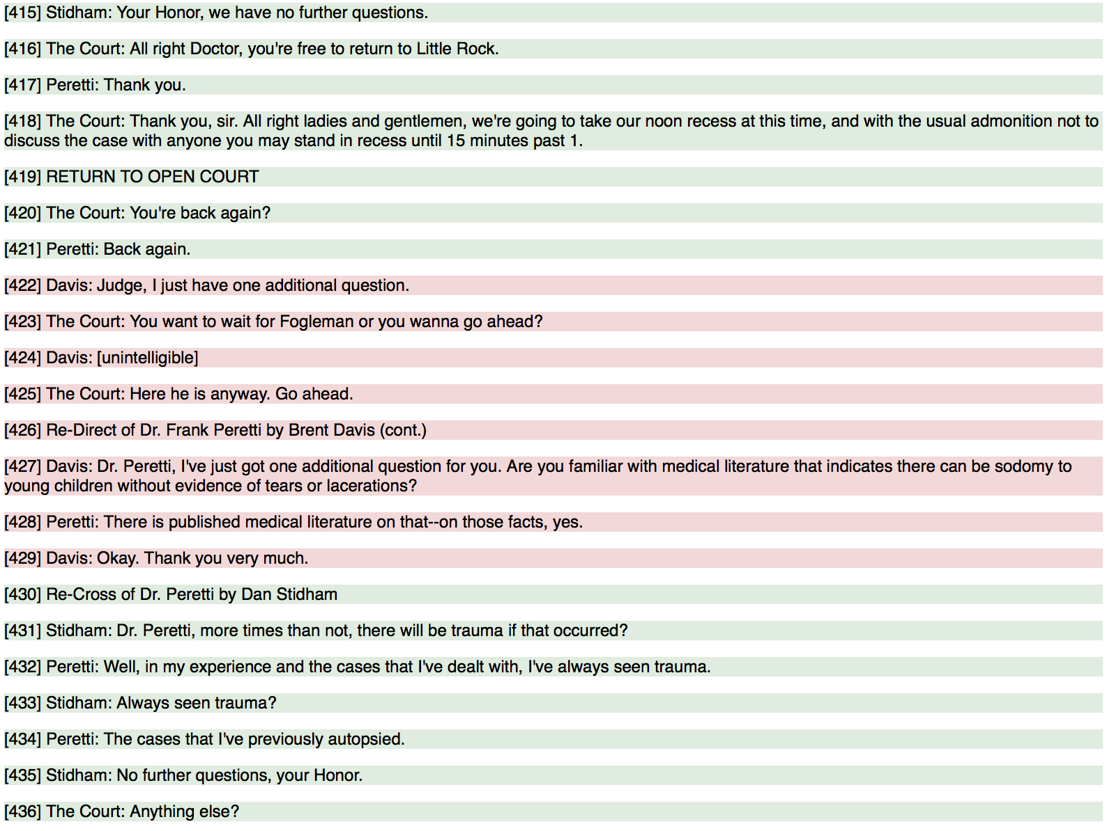
PD Annotation Makes it Easier to Understand Transcripts

Slide 4
PD Annotation Enables Objective Calculation of Content Balance

Slide 5
PD Annotation Enables Dialogue Documents to be Ranked by Contention (Attribution Switches)

Slide 6
More Thoughts
Can we quantify the degree by which Jessie mirrored the interrogators statements?
Detect and classify sentiment of dialogue – pieces to pay attention to is where sentiment is actually coming through.

